Slide 1
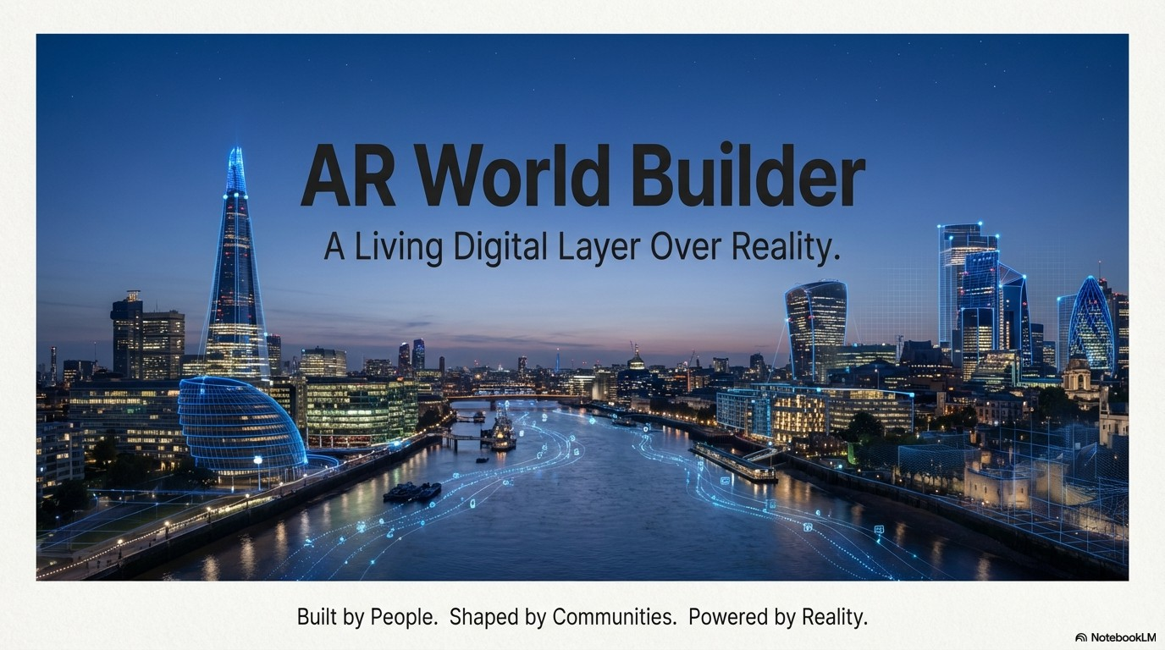

Slide 2
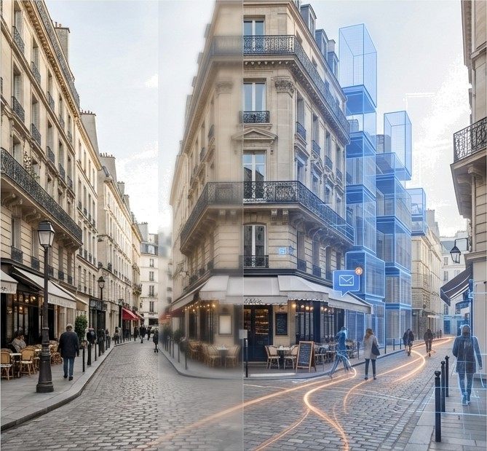

What if the real world was not just something see...
...but something you could build, shape,
and compete in?
AR World Builder turns real places into a shared, persistent digital world. Every user sees and interacts with the same digital layer, creating a collective experience tied to physical locations.
G NotebookLM

Slide 3
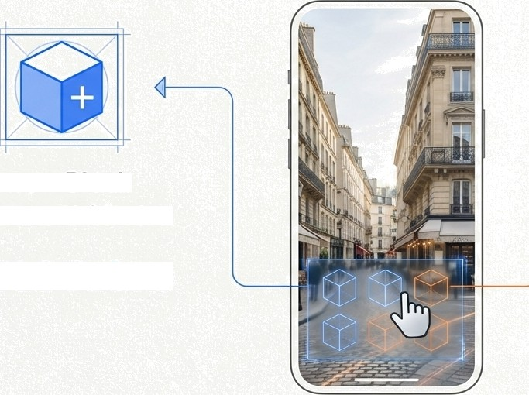

Blocks: The Foundation of the Shared World
Place a Block
Rewards the user with full points.
Destroy a Block
Rewards the user with one-fourth of the points. This simple mechanic creates a constant, competitive
flux in the digital landscape.
+100 Points
+25 Points
G NotebookLM

Slide 4
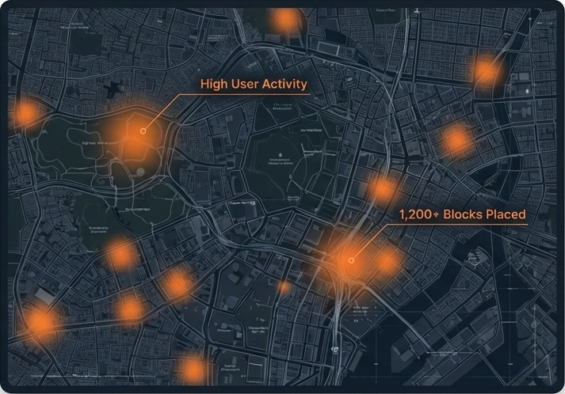
A Data-Driven Map Guides
Users to the Action
Users can switch from the live AR camera to a top-down map view of their city. The map is not static; it visualises real-time user engagement.
Feature Spotlight: Hotspots
Definition: Glowing areas on the map that indicate high concentrations of user activity and a large number of placed blocks.
Function: Hotspots serve as a natural guide, directing users to the most active and interesting places in the city, ensuring a concentrated and engaging social experience.
G NotebookLM

Slide 5


Engineering a Clean and Dynamic World
Turning Moderation into Gameplay
Ensuring a Constantly Evolving Landscape
Problem”: Unwanted or spam content.
Problem”: A static world cluttered with old content.
The community can mark certain blocks as 'spam’. Destroying these spam blocks gives the user higher point rewards. This gamifies moderation, incentivising users to keep the shared world clean.
Blocks are temporary by default and expire over time. Users who want their creations to last longer can pay to extend a block's duration, creating a core monetisation mechanic while preventing stagnation.
High Reward •$•
Pay to Extend Time _{O}
G NotebookLM

Slide 6


Driving Daily Engagement Through Competition
Leaderboard: London
All points earned from placing and destroying blocks are tallied on public leaderboards. This system
transforms individual actions into a city-wide sport.
C‹ty-Level
Area-Level
 |  |  | 1,450,210 pts
2 |  | @BIocksmith | 1,320,500 pts
3 |  | @GeoHacker | 1,298,150 pts
4 s | fi | @PixeIArchitect @UrbanBui1der | 1,105,890 pts 987,620 pts
Leaderboard Tiers
City-Level: Ranks the top players across the entire
metropolitan area.
Area-Level: Provides more granular rankings for local neighbourhoods, allowing more users to compete for the top spot in their immediate vicinity.
The constant race for status encourages daily, habitual engagement with the platform.
W NotebaokLM

Slide 7













Building Teamwork and City Pride with Communities
Beyond individual competition, users can form and join Communities within their city. These function as teams or guilds, creating a powerful social layer.
Users are no longer just playing for themselves; they are representing their community and their city.
Every block placed becomes a mark of collective identity.
The Shard Collective
Total Score: 12,834,500 pts
@• @Ape xBuilder
@City Zen
@ @DesignMaven OUrban Legend
PixelPro
”
Community Leaderboard
W NotebaokLM

Slide 8
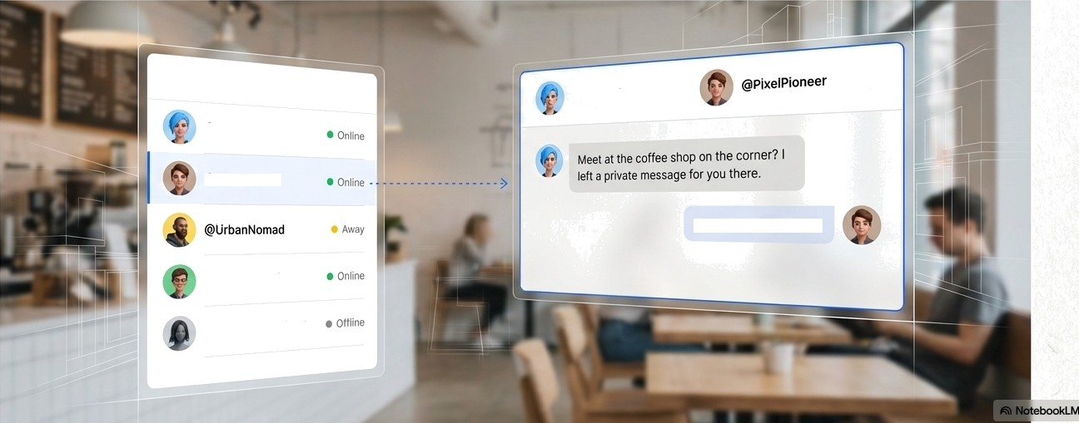

Forging Social Connections in the Real World
AR World Builder integrates core social features to build a network based on shared locations and experiences. This system builds social connections that are anchored to real-world places, creating a powerful retention mechanic.
eci yExplorer
OCit'/Ex_{piorer}
e i elPioneer
On my wayl See it now.
@DesignJunkie
_{gAuraT}heArChitect

Slide 9
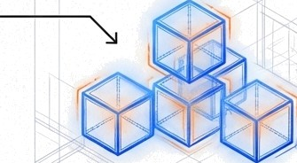



A Permanent Layer for Information and Communication
Alongside gameplay-oriented Blocks, the world contains Messages. These are a distinct
content type used purely for communication, with different rules and purposes.
BLOCKS MESSAGES
Temporary,
Gives Points
The Gameplay
Layer
Permanent,
No Points
The Communication
Layer
Welcome to our store!
Two Tiers of Communication
Visible only to a user‘s friends.
Created by Brands and visible to everyone.
W NotebaokLM

Slide 10



A Platform Built for Two Worlds: Players and Brands
The AR World Builder ecosystem is designed with two distinct user types, each with specific permissions and objectives. This dual-sided approach creates a balanced and sustainable economy.
Normal Users
Focus:
Gameplay, competition. social connection, and community building.
Brand Users
Focus:
Advertising, public communication, and brand presence.
Permissions:
Place/destroy blocks
Add friends
Create communities
Permissions:
Create public messages
Run targeted ad campaigns
Place custom branded 3D models
G
NotebookLtVi

Slide 11
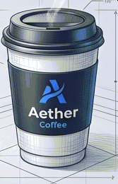
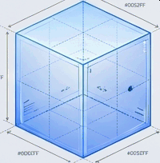

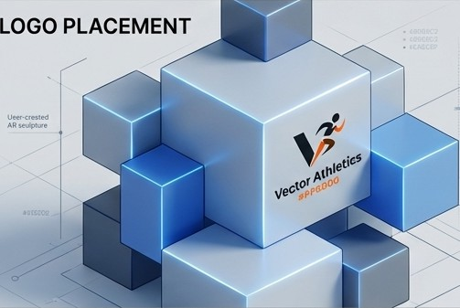
Monetisation Stream 1: Premium Customisation
BEFORE
AFTER
The platform offers a free usage period for several months to build a strong user base. Revenue is generated through high-value customisation options.
Monetisation Mechanics
Custom 3D Models: Both highly engaged users and brands can pay to import and place unique, custom 3D models into the world, moving beyond standard blocks.
Brand Logos: Brands can pay an additional fee to place their official logos directly onto objects within the AR world, creating powerful, native brand impressions.
G NotebaokLM

Slide 12
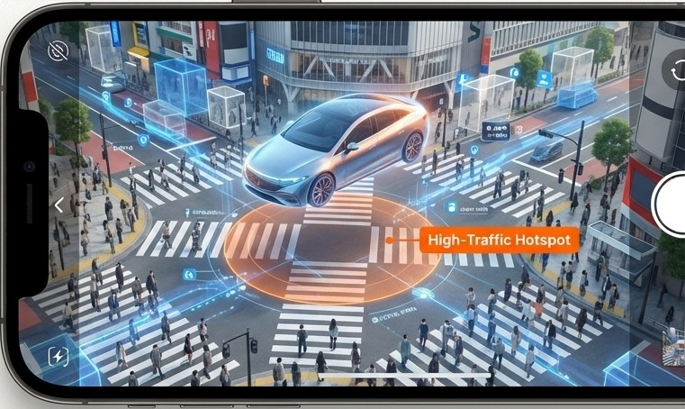
Monetisation Stream 2: Targeted, Location-Based Advertising
Brands and companies can run targeted
advertising campaigns directly within the AR world. Our model ensures ads are effective and relevant by tying them to real-world user density.
How lt Works
Ads are placed in high-aCtÎVity cities and concentrated within the data-identified Hotspots. This ensures that advertising impressions are served where the most users are physically present and actively engaged with the app.
A highly effective, location-based advertising channel that reaches an engaged audience in a nobel and memorable way.
G
NotebookLM

Slide 13
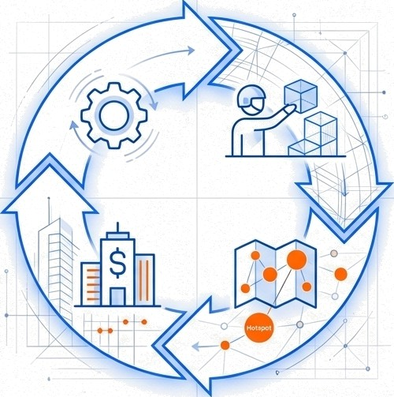
The AR World Builder Flywheel:
A Self-Reinforcing Ecosystem
4. Revenue Enhances the World:
Revenue is reinvested to improve the platform and add features, which in turn attFaEts and retains more users.
1. Engaged Users Play & Build:
Users place blocks and form communities, creating a vibrant world.
3. Brands Target Hotspots:
Brands are attracted to these dense user hubs and pay for advertising
and custom content.
2. Activity Generates Data:
This activity creates valuable data, identifying Hotspots of engagement.
’User enqngemenf creotes the dato thot drives inortetisution, which funds on ever-improving platform experience.”
G NotebookLM

Slide 14
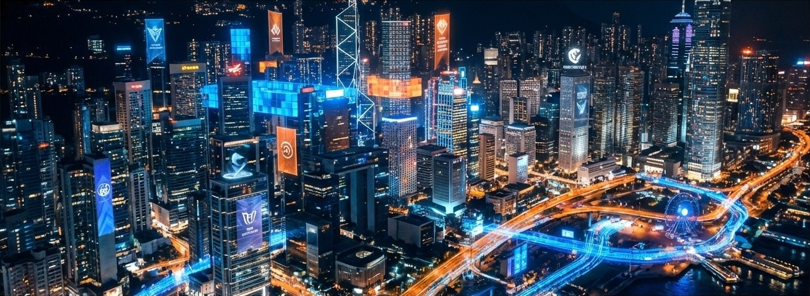
AR World Builder is not just a game. It is a living digital layer over the real world.
Built People.
Shaped Communities.
Powered Reality.

